Slide 1

TOPIC:
Computer Organization and Architecture
Basic Computer Organization: Memory Reference Instructions

Slide 2
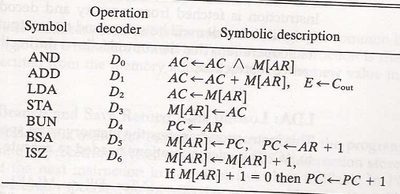
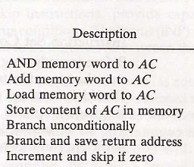
Memory reference instruction

Slide 3
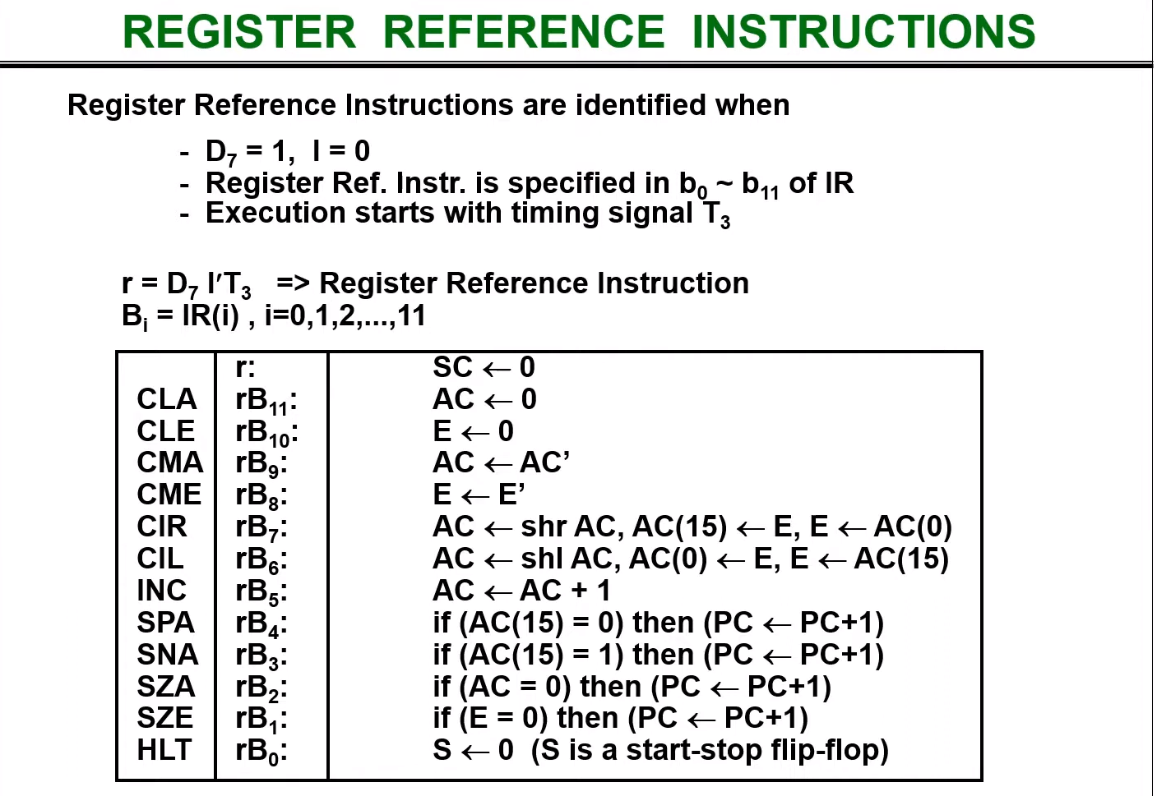

Slide 4
Memory reference instruction
Memory reference instructions are those commands or instructions which are in the custom to generate a reference to the memory and approval to a program to have an approach to the commanded information and that states as to from where the data is cache continually. These instructions are known as Memory Reference Instructions.
There are seven memory reference instructions which are as follows &
AND
The AND instruction implements the AND logic operation on the bit collection from the register and the memory word that is determined by the effective address. The result of this operation is moved back to the register.
ADD
The ADD instruction adds the content of the memory word that is denoted by the effective address to the value of the register.

Slide 5
LDA
The LDA instruction shares the memory word denoted by the effective address to the register.
STA
STA saves the content of the register into the memory word that is defined by the effective address. The output is next used to the common bus and the data input is linked to the bus. It needed only one micro-operation.

Slide 6
Memory reference instruction
BUN
The Branch Unconditionally (BUN) instruction can send the instruction that is determined by the effective address. They understand that the address of the next instruction to be performed is held by the PC and it should be incremented by one to receive the address of the next instruction in the sequence. If the control needs to implement multiple instructions that are not next in the sequence, it can execute the BUN instruction.
BSA
BSA stands for Branch and Save return Address. These instructions can branch a part of the program (known as subroutine or procedure). When this instruction is performed, BSA will store the address of the next instruction from the PC into a memory location that is determined by the effective address.
ISZ
The Increment if Zero (ISZ) instruction increments the word determined by effective address. If the incremented cost is zero, thus PC is incremented by 1. A negative value is saved in the memory word through the programmer. It can influence the zero value after getting incremented repeatedly. Thus, the PC is incremented and the next instruction is skipped.

Slide 7

1. AND to AC
This is an instruction that performs the AND logic operation on pair of bits in AC and the Memory word specified by effective address.
The result of the operation is transferred to AC.
The microoperation performed this operation are:
Total time cycle = 6

Slide 8

2. ADD to AC
This instruction adds the content of memory word specified by effective address to the value to AC.
The sum is transferred to AC and the output carry Cout is transferred to the E (extended AC) flip-flop.
The microoperation performed this operation are:
Total time cycle = 6

Slide 9

3. LDA : Load to Ac
This instruction transferred the content of memory word specified by effective address to the AC.
The microoperation performed this operation are:
Total time cycle = 6

Slide 10

4. STA : Store AC
This instruction store the content of AC in to the memory word specified by effective address .
The microoperation performed this operation are:
Total time cycle = 5

Slide 11

5. BUN: Branch Unconditionally
This instruction transfers the program to the instruction specified by the effective address. PC holds the address of instruction to be read from memory in the next instruction cycle.
It allows the programmer to specify an instruction out of sequence.
The microoperation performed this operation are:
Total time cycle = 5

Slide 12

6. BSA: Branch and Save return Address
This instruction is useful for branching to a portion of the program called a subroutine or procedure.
1st it stores the address of next instruction in sequence into memory location specified by effective address. Then effective address plus one is transferred to PC to serve the address of next instruction.
The microoperation performed this operation are:
Total time cycle = 6

Slide 13

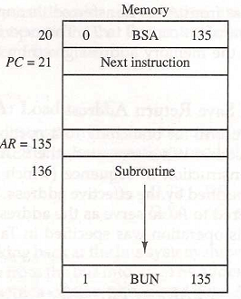
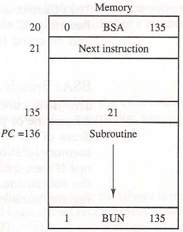
6. BSA:
Control Flowchart

Slide 14

7. INZ: Increment and Skip if Zero
This instruction increments the word specified by the effective address, and if increment value is equal to zero, PC is incremented by 1.
The microoperation performed this operation are:
Total time cycle = 7

Slide 15
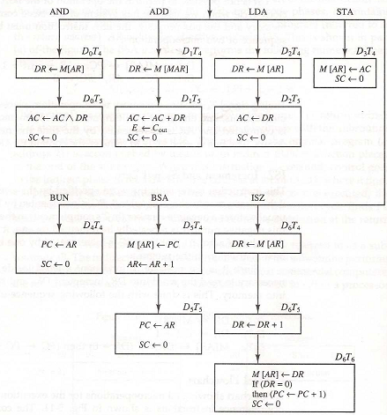
Control Flowchart

Slide 16
Input-Output and Interrupt

Slide 17
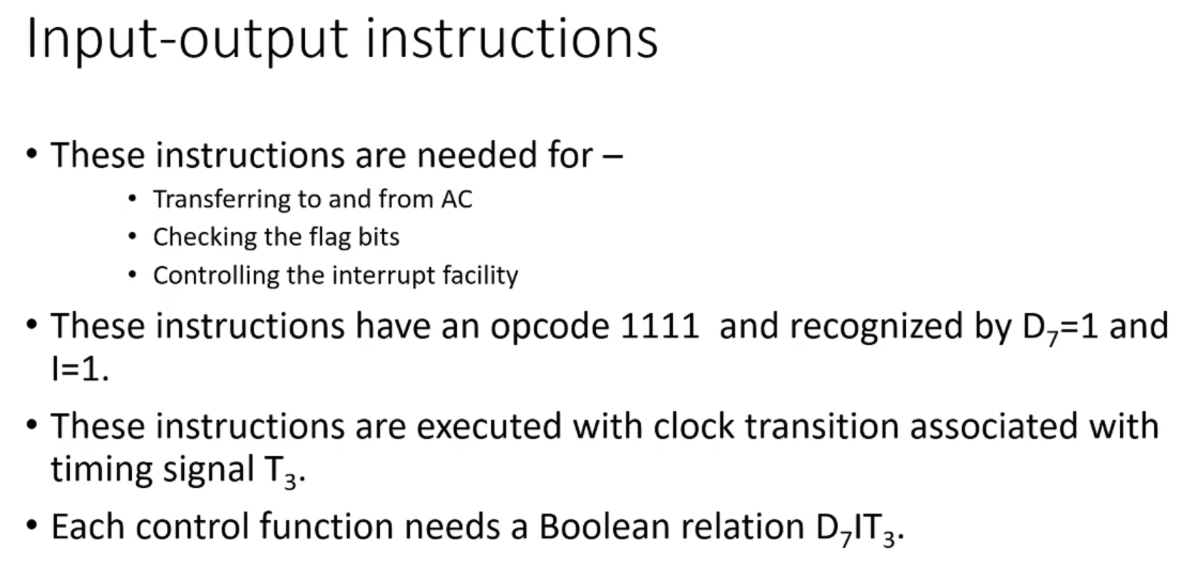

Slide 18
Introduction
A Computer can serve no useful purpose unless it communicate s with the external environment.
Instructions and data stored in memory must come from some input device.
Computational results must be transmitted to user through some output device.
Commercial computers include many types of input and output devices.
To demonstrate the most basic requirements for input and output communication, we will use as a illustration a terminal unit with a keyboard and printer.

Slide 19
Input-Output Configuration
The terminal sends and receives serial information.
Each quantity of information has eight bits of an alphanumeric code.
The serial information from the keyboard is shifted into the input register INPR.
The serial information for printer is stored in output register OUTR.
These two registers communicate with communication interface serially and with the AC in parallel.

Slide 20
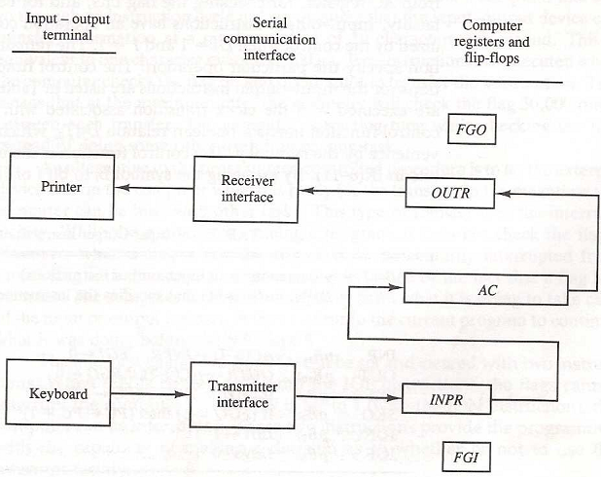
Input-Output Configuration

Slide 21
Input-Output Flags
1 bit input flag FGI is a control flip-flop. The flag bit is 1 when new information
is available in input device and cleared to zero when accepted by computer.
Flag is used to synchronize the timing rate difference between input device
and computer.
Initially FGI is set to 0. when a key is struck in the keyboard, an 8-bit
alphanumeric code is shifted in to INPR and the input flag FGI is set to 1.
The output register OUTR works similarly but the direction of information flow
is reversed.
Initially, the output flag FGO is set to 1.
Computer checks FGO, and if it is 1, the information from AC is transferred in
a parallel to OUTR and FGO is cleared to 0.

Slide 22
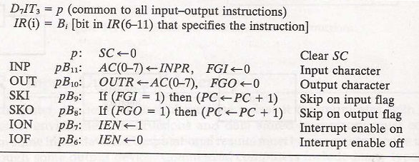
Input-Output Instructions.
For this type of information I=1, and
D7 (i.e. IR(12-14)=111)
For basic Computer only 6 input-output instruction.

Slide 23
Program Interrupt
An alternative to the programmed controlled procedure is to let the external device inform the computer when it is ready for the transfer.
In the meantime computer can be busy with other tasks.
This type of transfer use the interrupt facility. While computer is running the program, it does not check the flags, however when a flag is set then computer receives an interrupt.
The interrupt enable flip-flop IEN can be set and cleared with two instructions.
When IEN is cleared to zero (with IOF instruction), the flag can not interrupt the computer.
When IEN is cleared to 1 (with ION instruction), the computer can be interrupted.

Slide 24
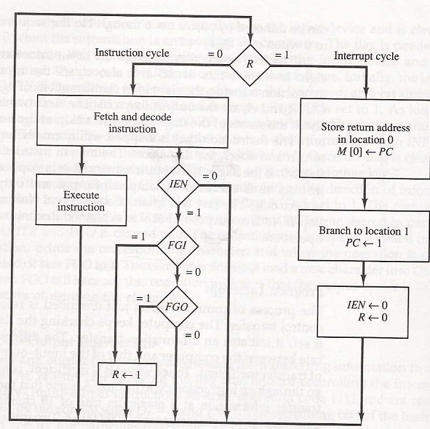
Flowchart of Interrupt cycle

Slide 25
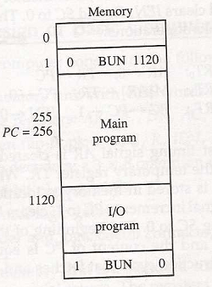
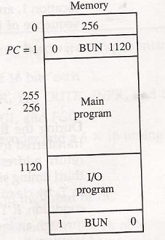
Interrupt E.g.
M[0] <- PC
PC <-M[1]

Slide 26
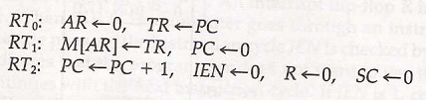
Interrupt cycle
Here the modified fetch and decode phase of interrupt cycles as follow:

